Slide 1
New York City: The Global Business Capital
Naomi Fujiki, Vice President
Strategic & International Partnerships

Slide 2
Agenda:
Who We Are
Why NYC
Business Support

Slide 3
Building strong neighborhoods, creating good jobs

Slide 4
Develop City-owned assets (6 million square meters)
Create quality jobs
Promote livable communities
Invest in growing industries
Help companies start and grow in NYC

Slide 5
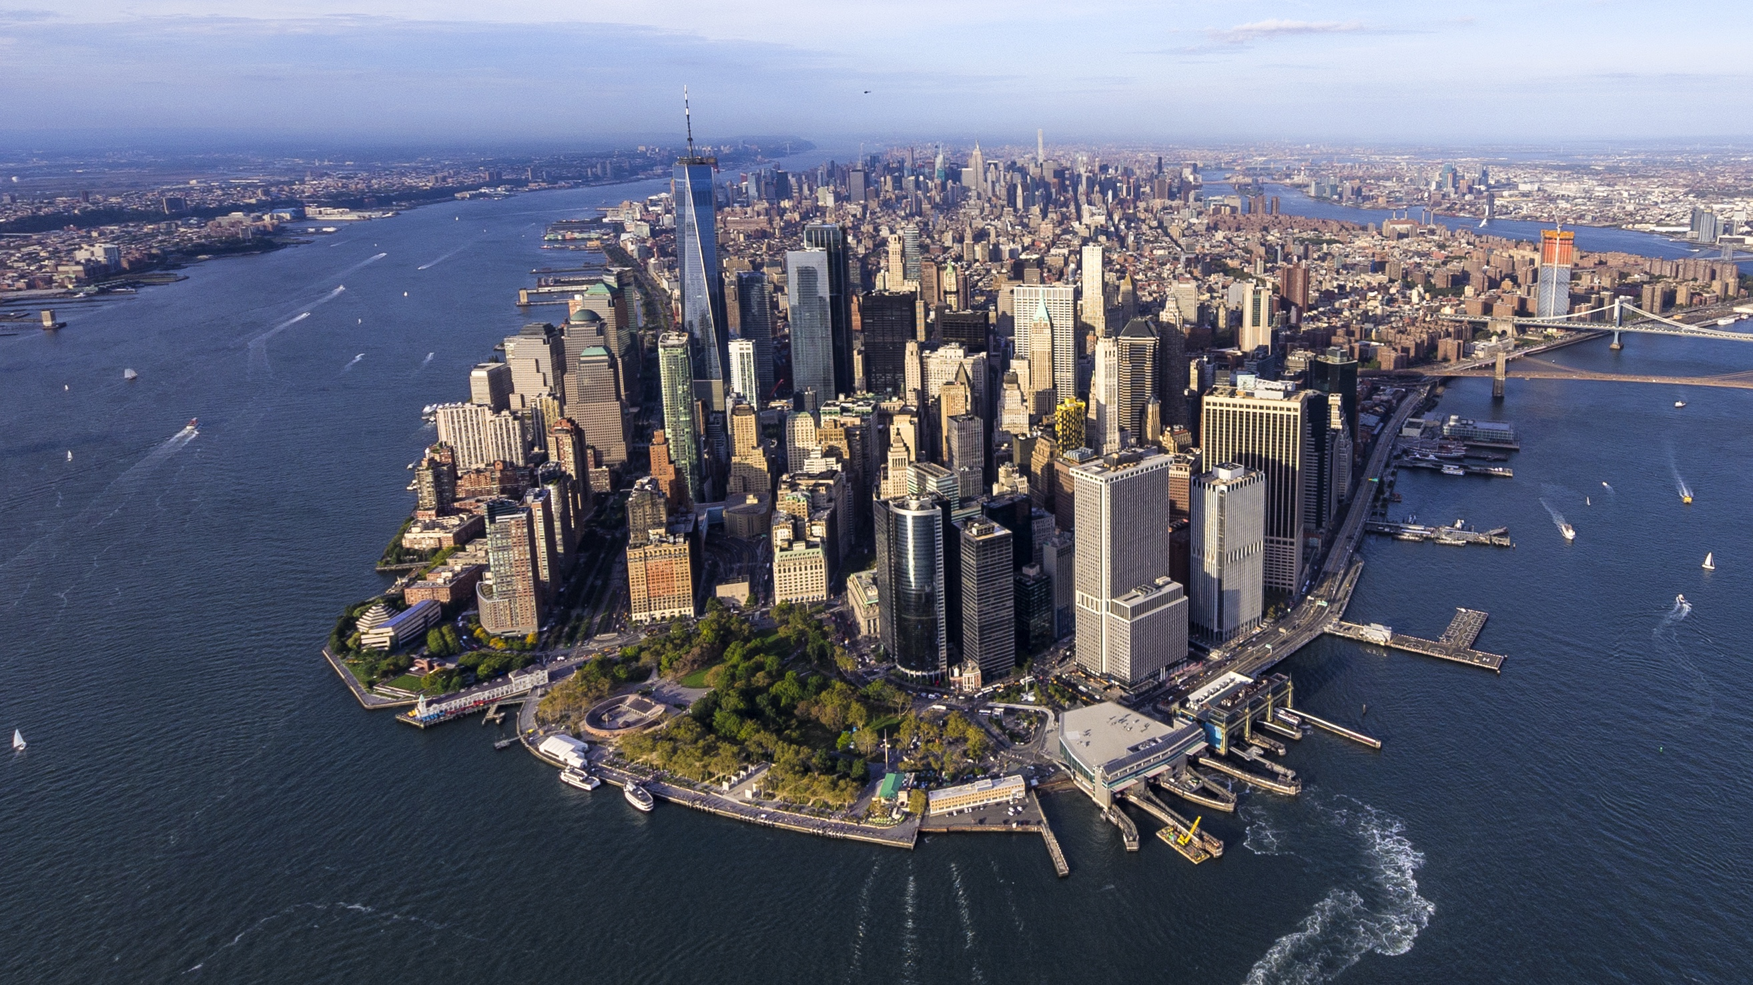
Why NYC:

Slide 6
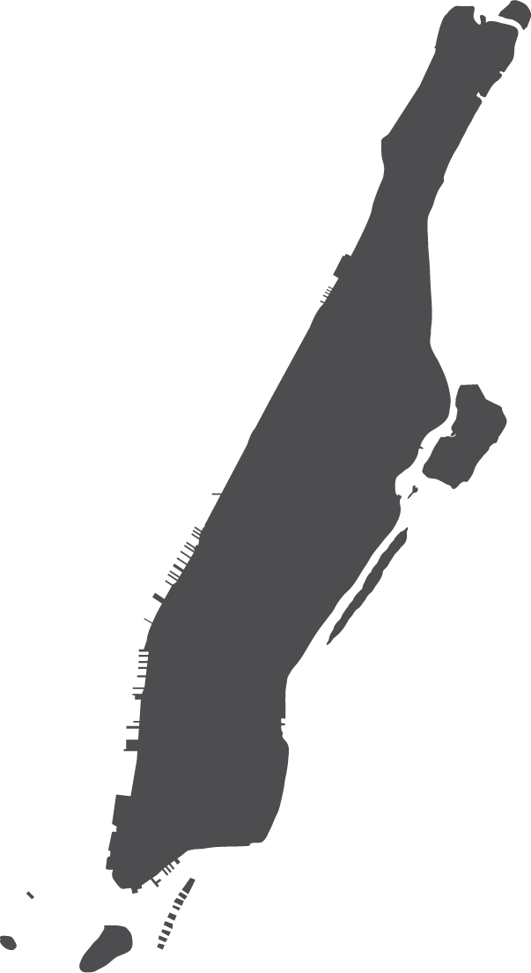
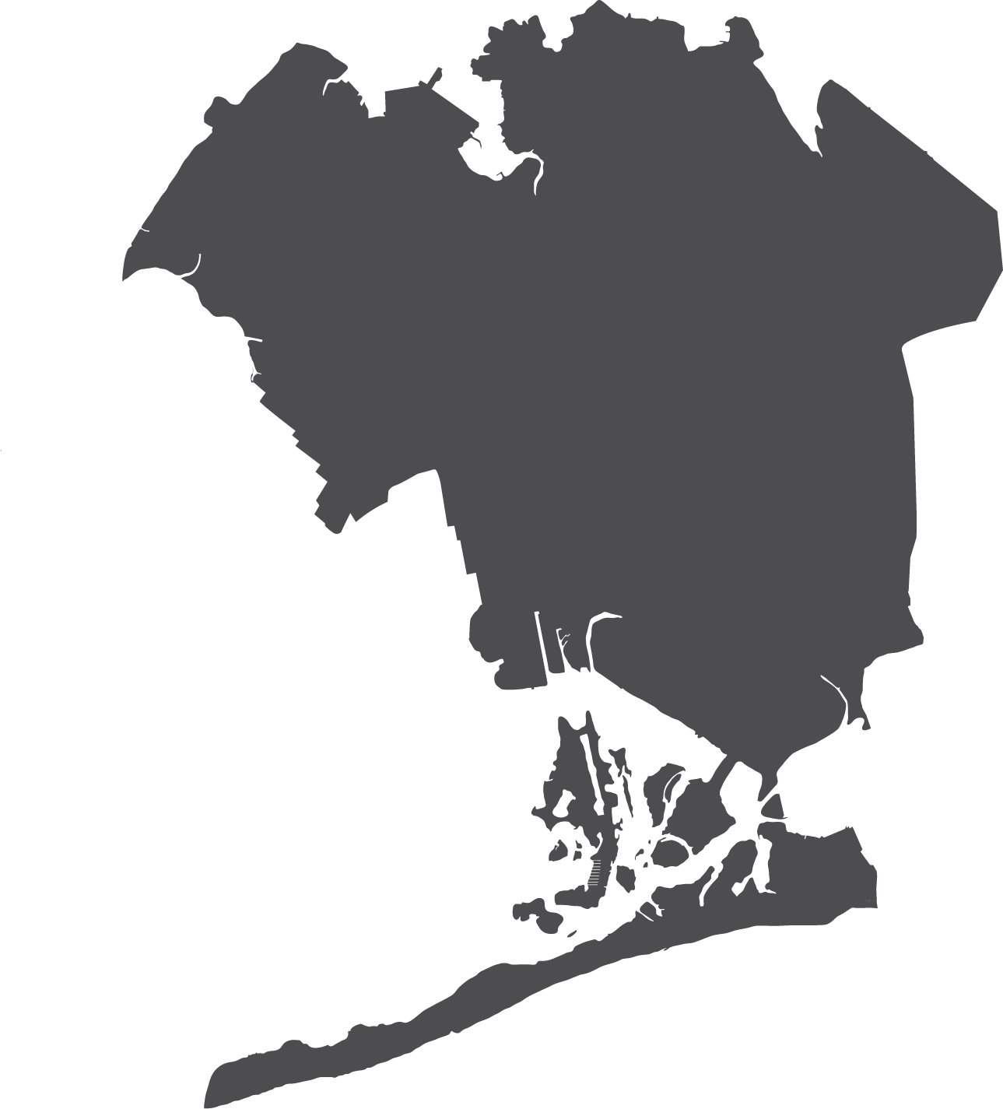
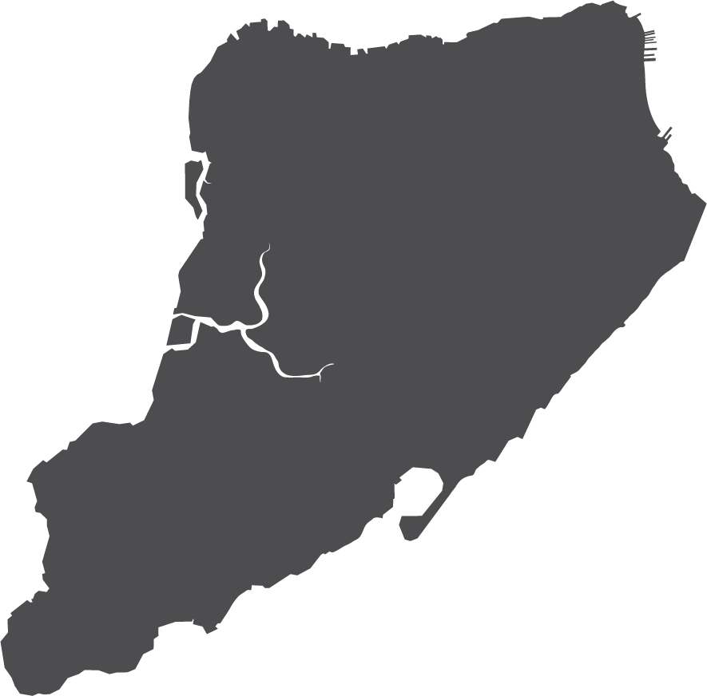
The Place:

Slide 7
The largest U.S. city
8 million residents
The Talent:
Labor force of 4+ million
3.2 million with a Bachelor’s degree or higher
100+ institutions of higher learning

Slide 8
20 million consumers
$1.66 trillion GMP
Consumer Base:
The 10^{th-}largest world economy
200k+ small-to-medium businesses
Headquarters of 47+ Fortune 500 companies

Slide 9
37 percent of our population is born abroad
Diversity:
Immigrants are 47 percent of our workforce
800+ languages spoken

Slide 10
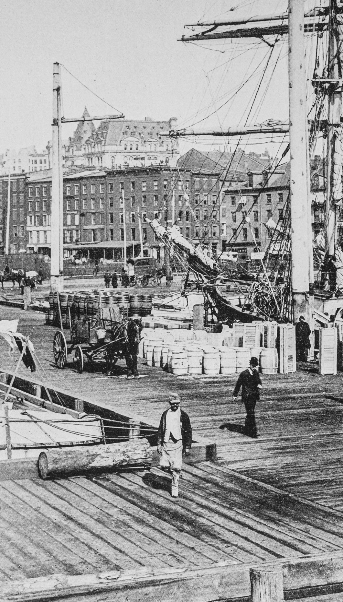
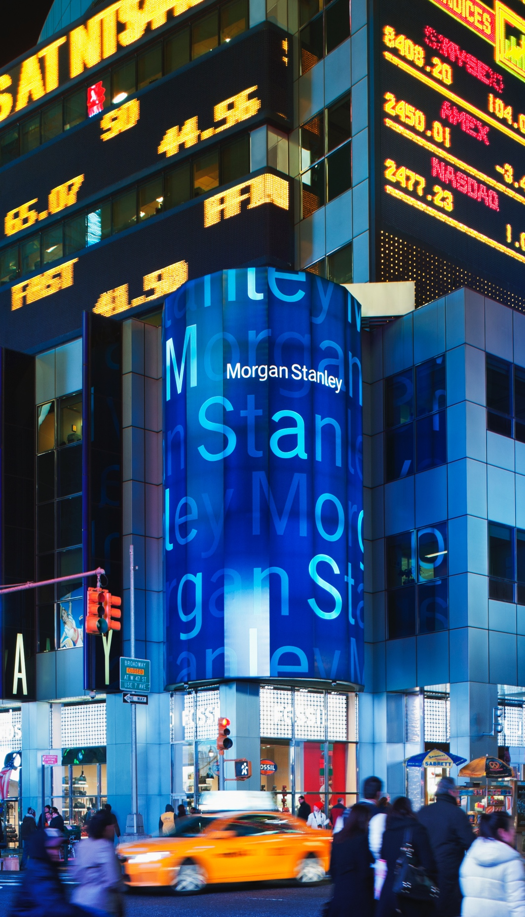

Slide 11
4,300,000
The “down” moments have always been the best time to invest in NYC…
August 1969
October 1987
January 2001
August 2008
July 1977
November 1992
August 2003
August 2009
NYC Private Sector Jobs
We’ve always come back better and stronger than before.
2,500,000
January 1958–August 2019
Source: New York State Department of Labor (CES); NYC data seasonally adjusted by NYCOMB; national recessions from the National Bureau of Economic Research, US Business Cycle Expansions and Contraction

Slide 12
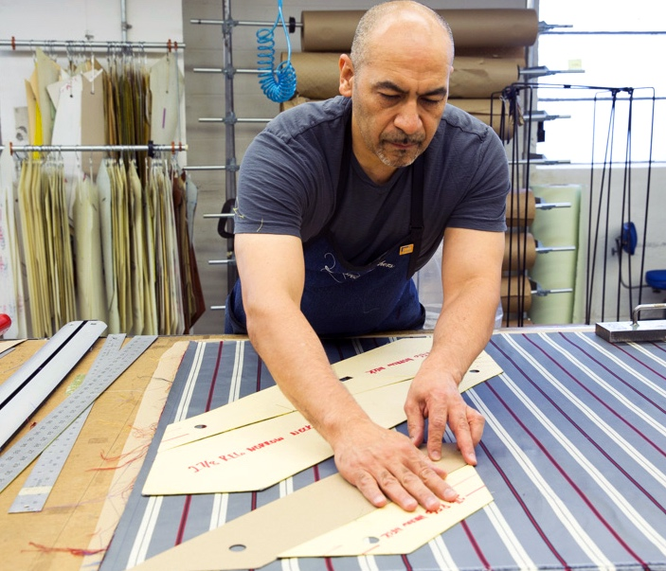
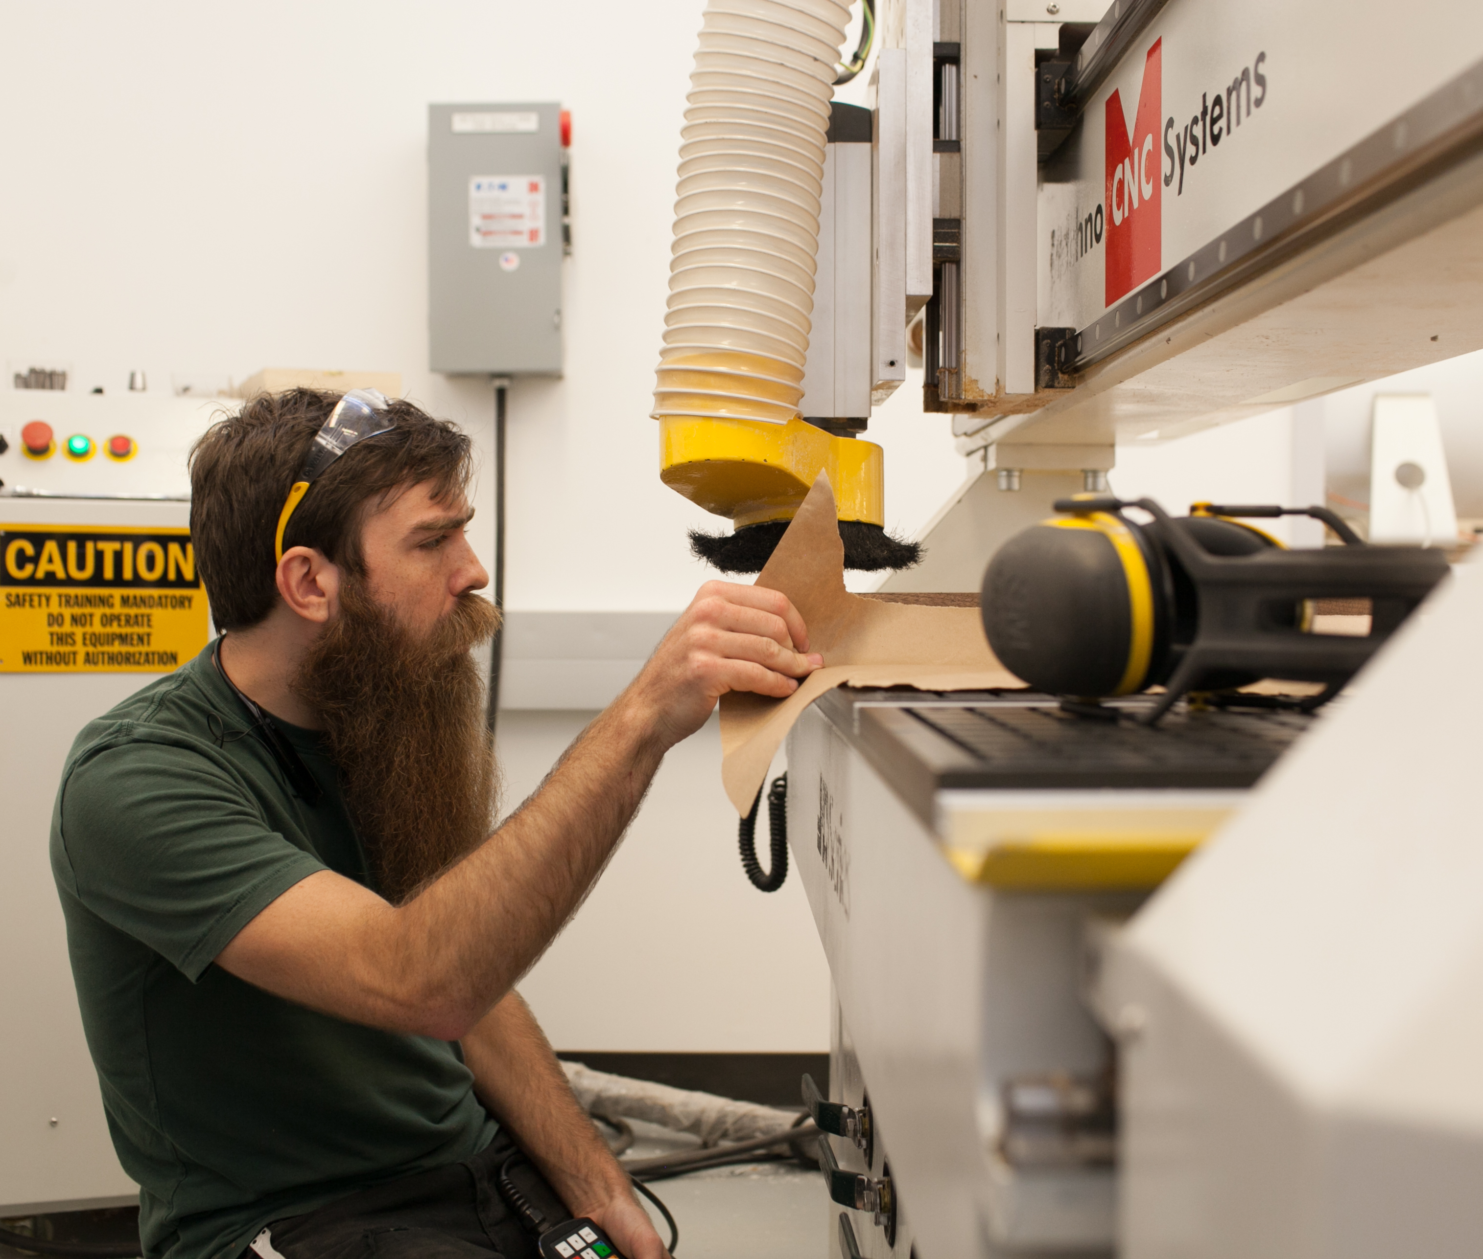

Slide 13
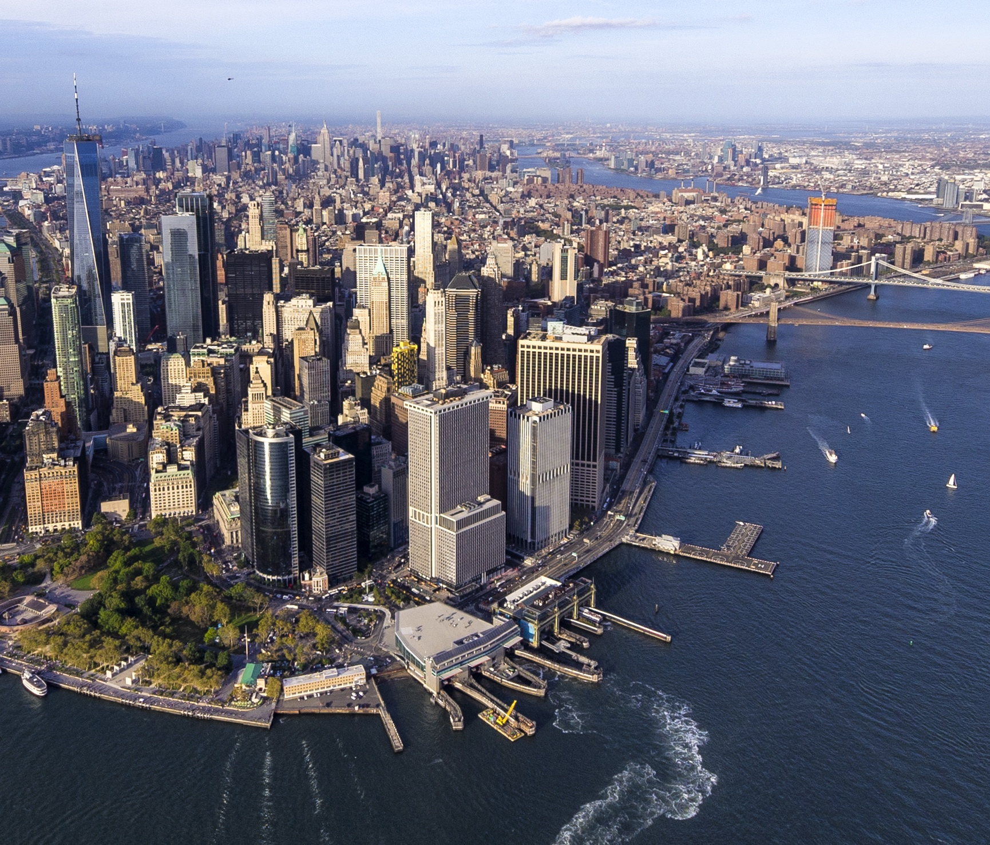
Major tech companies
9,000+ startups
Startup ecosystem $147B
100+ tech incubators
330,000+ pool of tech talent
Tech:

Slide 14
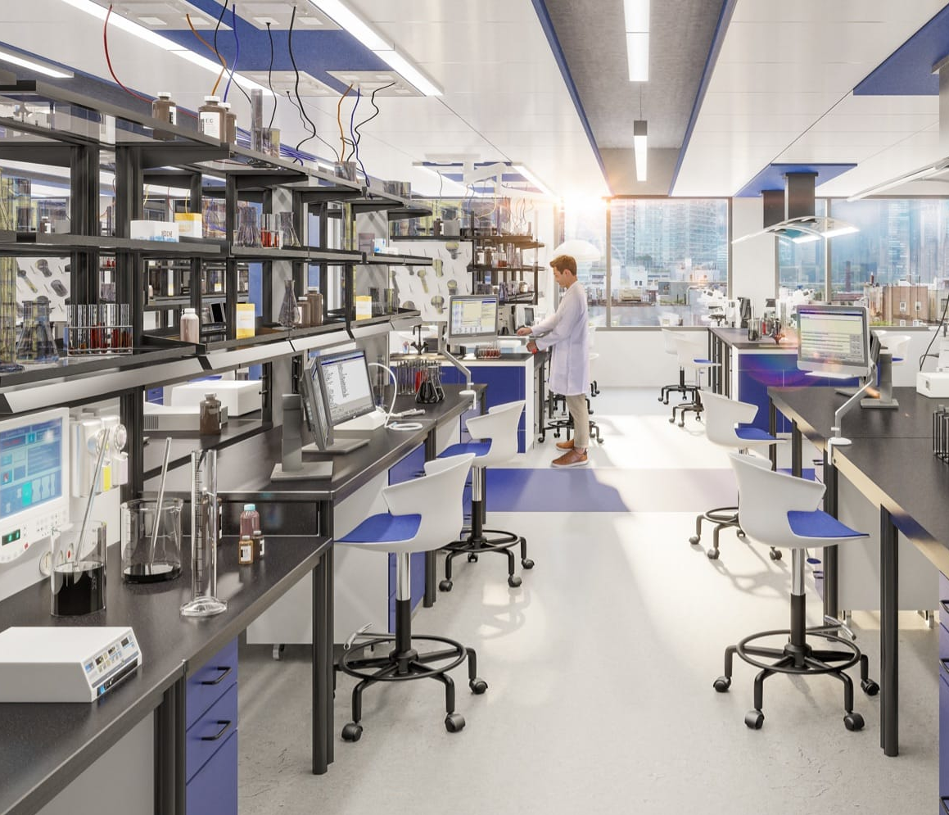
9 academic medical centers
50 hospitals
370 healthcare centers
$2B+ National Institutes of Health awards
Largest biotech workforce
Life Sciences:

Slide 15
NY leads the US in climate legislation
NYC spending $4B on retrofitting its assets through 2030
Private sector spending $20-30B on retrofitting
850,000+ green economy workers
Green Economy:

Slide 16
NYC is:
a global business destination

Slide 17
The Business Development Team can assist you with:
Private Site Selection
City Procurements
City-Owned Property
Way Findings
Financial Solutions
Academic Integration
Workforce Consultation
Ecosystem Connections
Industry Programs
Trade & Investment Connections

Slide 18
EDC Resources: https://edc.nyc/business-development
Business Resource Guide
NYC business ecosystem and communities
Business Improvement Districts and Chambers of Commerce
Workforce development guide
EDC real estate opportunities
Legal resources
Business Incentives Guide
Construction, affordable housing, manufacturing, life sciences, economic revitalization zones

Slide 19
Additional Resources:
City Resources
NYC Department of Small Business Services (SBS) helps businesses form and grow
Mayor’s Office for International Affairs connects international businesses to resources
Statewide Resources
New York Business Express is an online guide to help start, run, and grow a business
START-UP NY Program helps businesses operate tax-free for 10 years on eligible campuses
NYSTAR Innovation Hot Spots and Certified Business Incubators

Slide 20
Contact: nfujiki@edc.nyc
Learn more: edc.nyc

Slide 21
Appendix

Slide 22
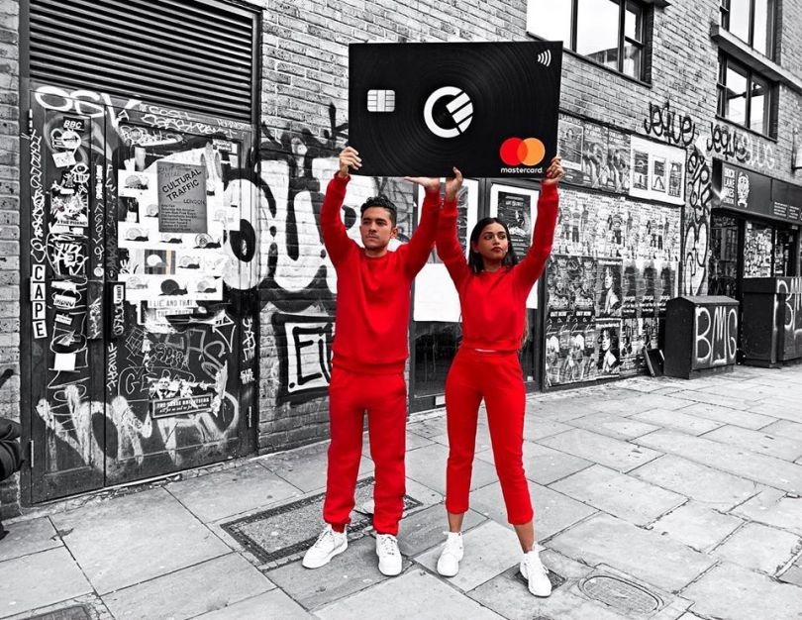
Business Attraction:
Curve

Slide 23
Business Attraction:
Curve
Economic Wayfindings
Ecosystems Connections

Slide 24
Business Attraction:
Curve
NYC won the project and Curve was announced on February 10, 2020, bringing 185 good-paying jobs—and the resulting tax revenue—to the City

