Slide 1
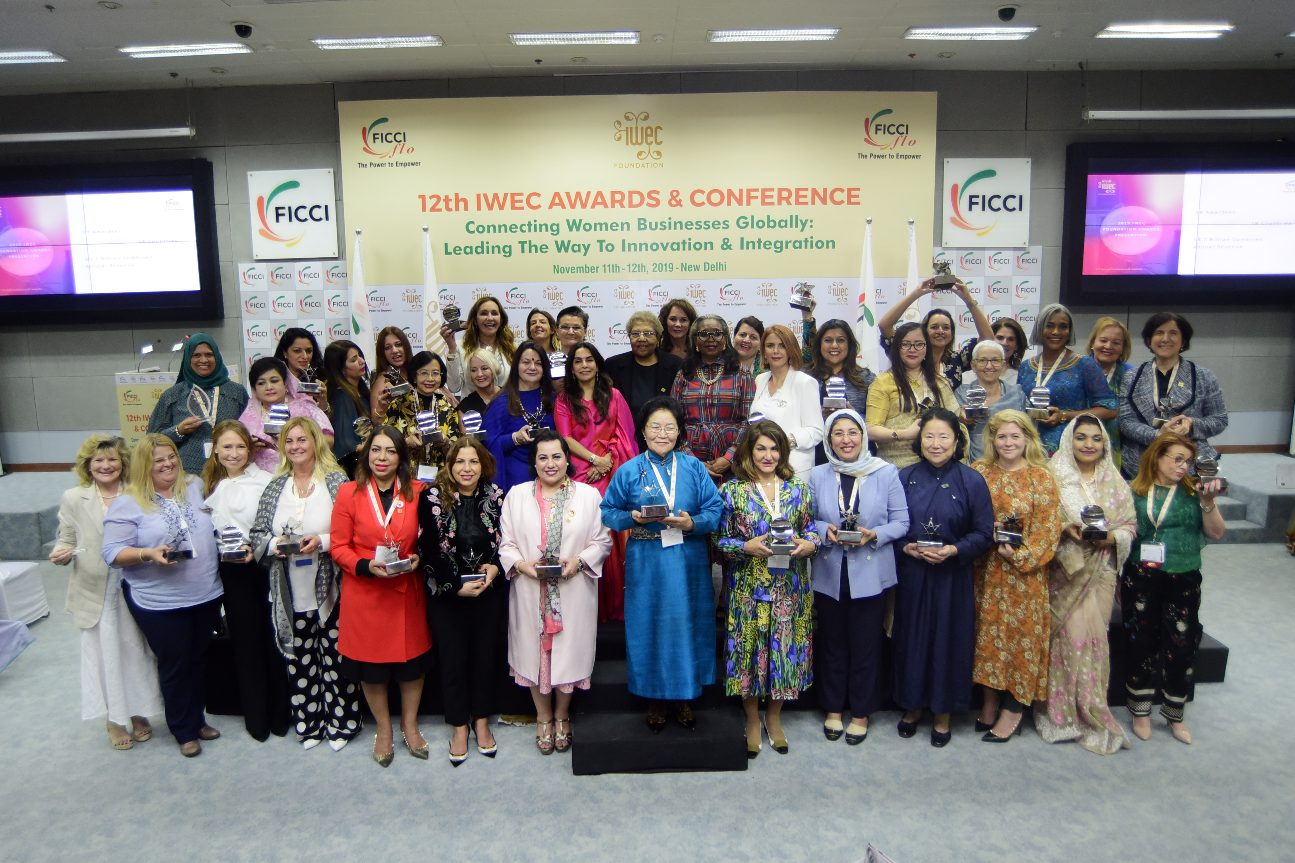
INTERNATIONAL WOMEN’S ENTREPRENEURAL CHALLENGE FOUNDATION
COVID-19 Survey Results | April 2020

Slide 2
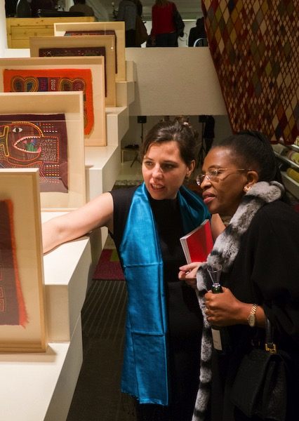
RESPONDENT DATA
A group of 50 highly successful international businesswomen - who are influential leaders in their respective fields — responded to our global COVID-19 survey illustrating the effects the pandemic has on their businesses.
18Countries
27 Industry sectors & service providers
Annual Revenue Range: $1.5 millUS-$2.0 billion US
COVID-19 SURVEY | 2

Slide 3
INDUSTRIES REPRESENTED
COVID-19 SURVEY | 3

Slide 4
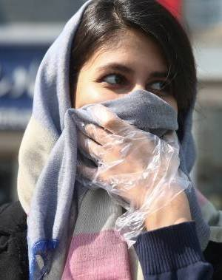
CURRENT LEVEL OF CONCERN
COVID-19 SURVEY | 4

Slide 5
BUSINESS IMPACT
LAYOFF OF EMPLOYEES
CUSTOMER BASE
20% WORKFORCE LAYOFFS
63% LOSS OF CUSTOMERS
SUPPLY CHAINS
IMPACT ON REVENUE
65% ADVERSELY AFFECTED
62% DECREASE EXPECTED
28% UNCERTAIN
10% INCREASE
COVID-19 SURVEY | 5

Slide 6
TOP THREE CONCERNS
HEALTH RISKS - SPREAD OF THE VIRUS - LOSS OF LIFE – TIME TO FIND VACCINE
MANAGING HUMAN RESOURCES – MANAGING REMOTE WORKERS – MORALE –
WORKING SAFELY
PIVOTING TO A NEW OPERATING MODEL
LOSING MARKET SHARE - IDENTIFYING NEW MARKETS - KEEPING CUSTOMERS & ATTRACTING NEW
CASH FLOW – LOSS OF REVENUE – INABILITY OF CUSTOMERS TO PAY – ACCESS TO NEW
LINES OF CREDIT & LOANS – KEEPING CUSTOMERS & ATTRACTING NEW
DISRUPTION IN PRODUCTION – LOGISTICS
GLOBAL FINANCIAL UNCERTAINTY -
IMPACT ON EVERYDAY LIVES – SOCIAL UNREST –WHAT WILL THE “NEW NORMAL” LOOK LIKE?
RECOVERY PROCESS & TIME AFTER LOCKDOWN – CONSUMER CONFIDENCE
LONG TERM IMPACT GLOBALLY – INABILITY TO TRAVEL TO DEVELOP NEW MARKETS
COVID-19 SURVEY | 6

Slide 7
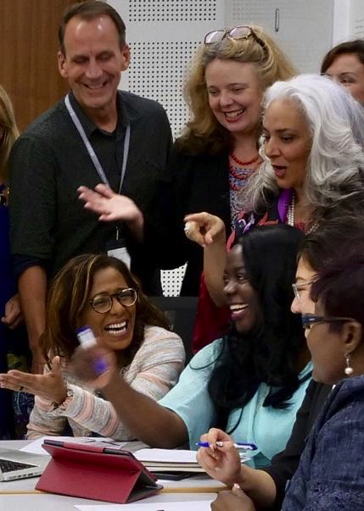
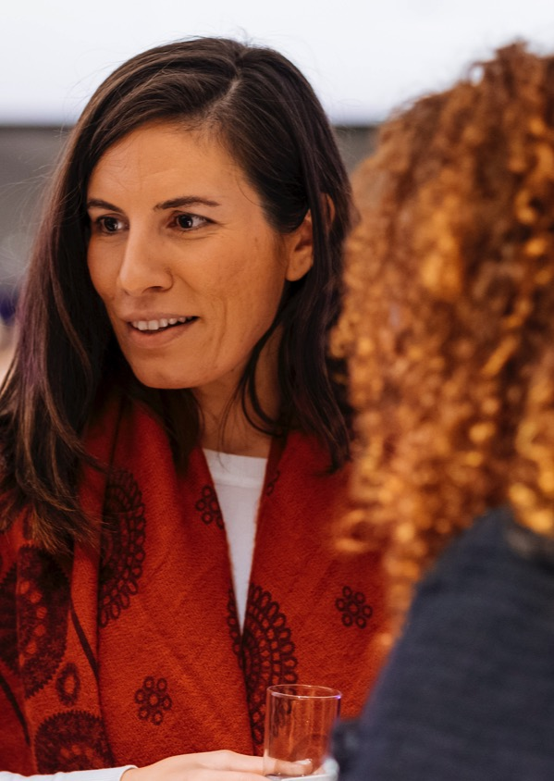
FINANCIAL ACTION OPTIONS
IMPLEMENTING COST CONTAINMENT
CHANGING COMPANY FINANCING PLANS
48%
CHANGING M&A
52%
DEFERRING OR CANCELLING PLANNED INVESTMENTS
STRATEGY
30%
22%
NO CHANGES NOW
22%
COVID-19 SURVEY | 7

Slide 8
IF COVID-19 WERE TO END TODAY HOW LONG WOULD IT TAKE FOR YOUR COMPANY TO
GET BACK TO “BUSINESS AS USUAL?”
Less than one month 22%
1-3 months 20%
3-6 months 24%
6-12 months 20%
More than 12 months 14%
COVID-19 SURVEY | 8

Slide 9
COMPANY IMPACT
INCOME LOSS – 76%
INCOME GAIN -6%
PRODUCTIVITY LOSS-50%
PRODUCTIVITY INCREASE – 8%
GOVERNMENT DEMANDS FOR INCREASED EMPLOYEE BENEFITS-22%
CHANGES IN STAFFING:
DUE TO LOW CUSTOMER DEMAND– 32%
DUE TO HIGH CUSTOMER DEMAND–4%
INSUFFICIENT STAFFING TO PRODUCE DUE TO COVID-19–8%
COVID-19 SURVEY | 9

Slide 10
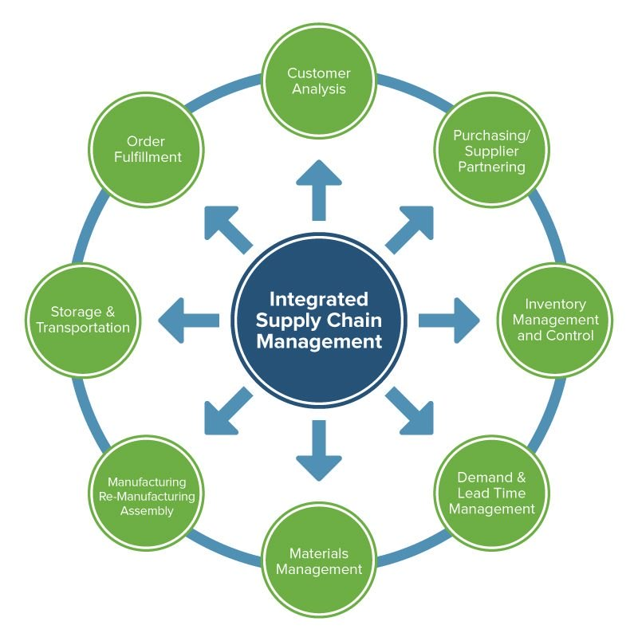
SUPPLY CHAIN
ARE YOU CONSIDERING CHANGING THE BREATH OF YOUR SUPPLY CHAIN (E.G. VENDORS,FACILITIES, MARKETS)?
YES – 28%
NO – 40%
UNCERTAIN – 32%
COVID-19 SURVEY| 10

Slide 11
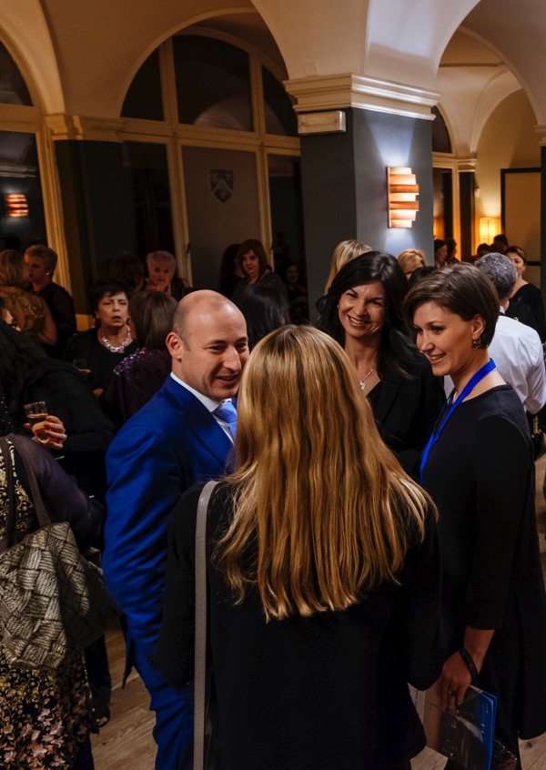
GOVERNMENT SUPPORT
IS YOUR NATIONAL/STATE/CITY GOVERNMENT SUPPORTING YOUR COMPANY?IF SO, WHAT ARE THEY DOING?
YES – 56% NO – 42% UNCERTAIN – 2%
----------
TAX DEFERMENT & CONCESSIONS
OFFERING GUARANTEED LOANS – LOAN GRACE PERIODS
EMPLOYEE WAGE SUPPORT
OFFERING MONETARY GRANTS UP TO $10,000US
WAIVED ELECTRIC PAYMENTS FOR 3 MONTHS
LABOR INSURANCE REDUCTION BY 45%
PAYING 6 MONTHS RENT AND ELECTRIC FOR OUR EMPLOYEES
COVID-19 SURVEY| 11

Slide 12
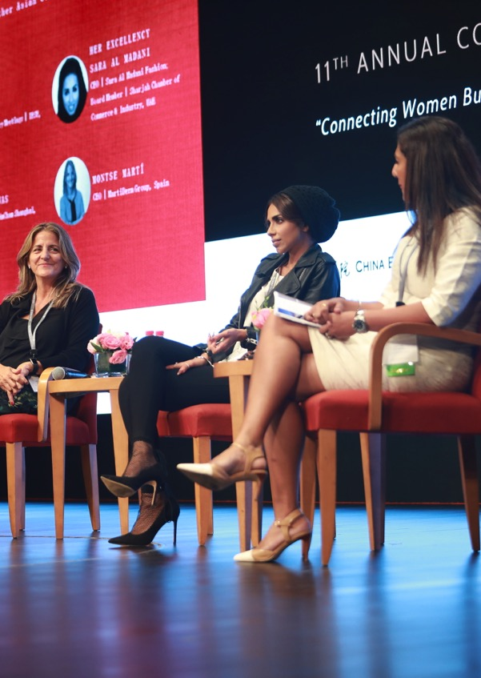
FOREIGN MARKETS
DO YOU PLAN TO RAMP UP YOUR STRATEGY TO PENETRATE ADDITIONAL FOREIGN MARKETS TO MAKEE UP FOR LOSSES AT HOME?
YES – 43%
NO – TOO MUCH UNCERTAINY – 57%
COVID-19 SURVEY| 12

Slide 13
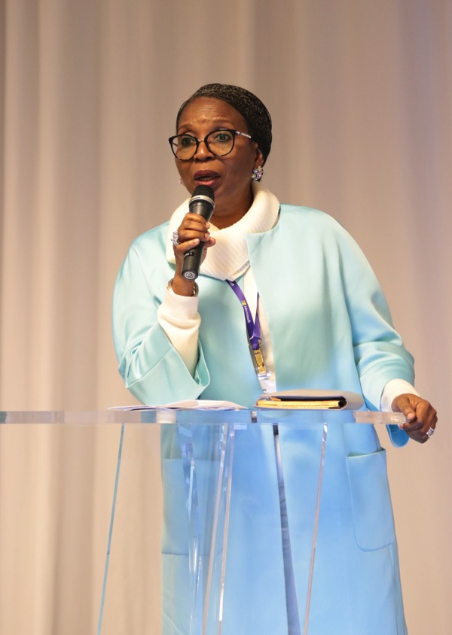
ISSUES CRITICAL TO SUSTAINING YOUR BUSINESS NOW
CASH FLOW – CREDITORS – PAYROLL – STEADY INCOME
EMPLOYEE HEALTH & MORALE – PROTECTION PROTOCOL FOR WORKERS
ATTRACTING NEW BUSINESS - LACK OF SALES/BUYERS
GLOBAL ECONOMIC RECESSION – FINANCIAL UNCERTAINTY
TECHONOLGY ENHANCEMENT – CONVERTING TO AND TRAINING EMPLOYEES TO USE
GENERATING NEW SOURCES OF INCOME – INNOVATIVE WAYS TO STAY AFLOAT
LACK OF TRAVEL – ENTERTAINMENT – TOURISM – RESTAURANT PATRONAGE
UNCERTAINTY / CHANGING OF PRODUCTION TIMING
LONG TERM IMPACT GLOBALLY – INABILITY TO TRAVEL TO DEVELOP NEW MARKETS
COVID-19 SURVEY | 13

Slide 14
IWEC FOUNDATION SPONSORS
FOUNDING
DIAMOND
GOLD
SILVER
BRONZE
FRIENDS
COVID-19 SURVEY | 14

Slide 15
IWEC FOUNDATION
IWEC FOUNDATION Nancy Ploeger | Executive Vice President & Secretary of the Board
917.796.4201
54 W. 40th Street, Suite 1117 New York, NY 10018 USA
www.iwecfoundation.org
nancyp@iwecfoundation.org
COVID-19 SURVEY | 15

Slide 16
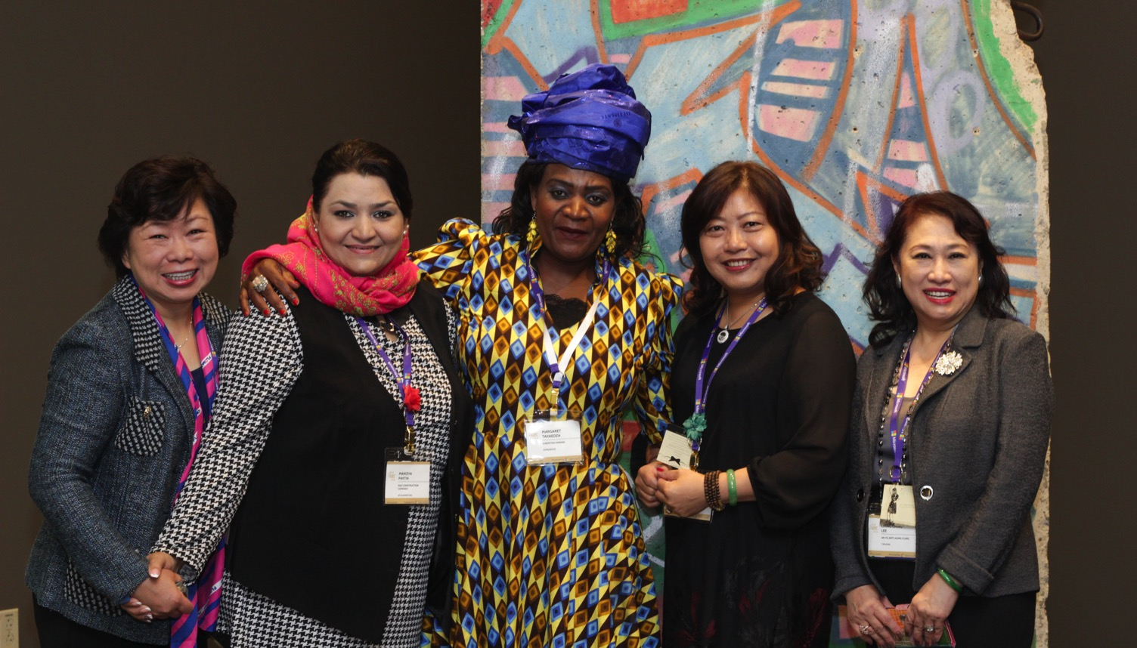
THANK YOU!

